Slide 1
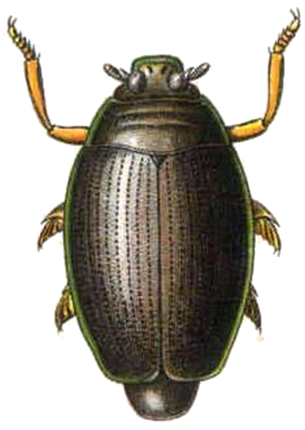
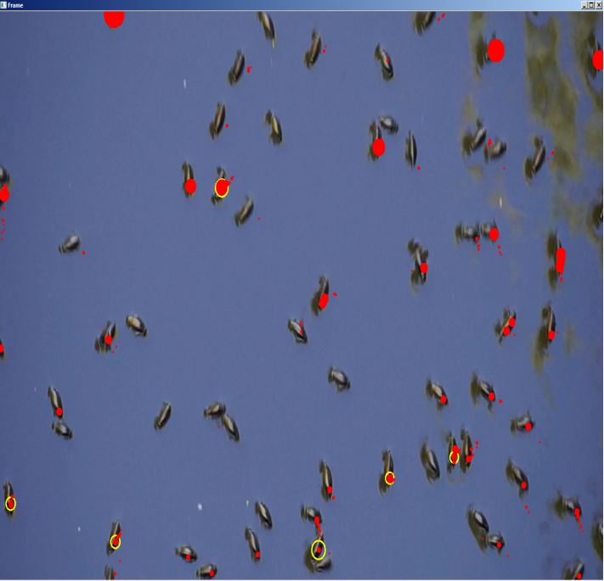
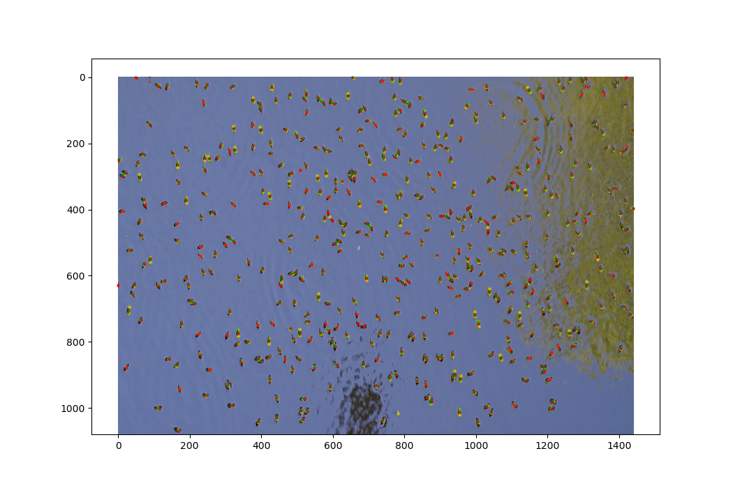
Project Whirligig
Before Filtering
After Filtering
Object Detection/Tracking
Single Frame/Multi Frame
Open CV
Modeling
Net Logo
Neural Network
Tensor Flow

Slide 2
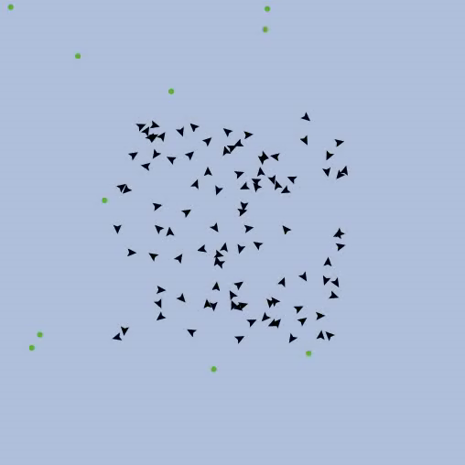
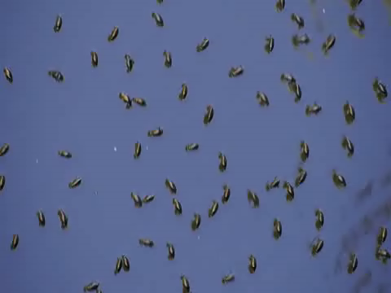
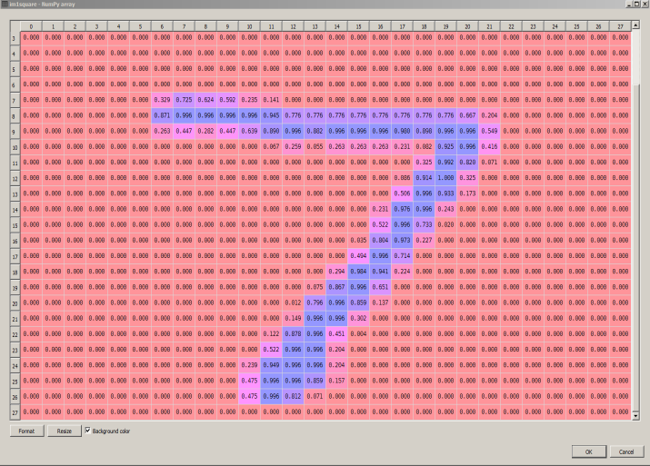
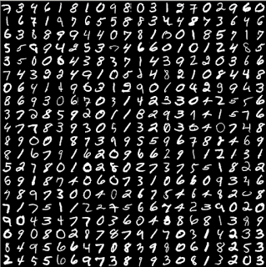
Project Whirligig
Net Logo
Artificial Neural Networks

